Slide 1

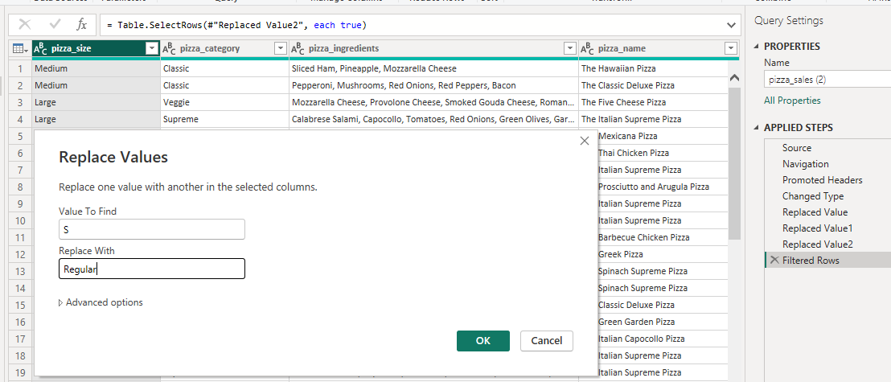
DATA CLEANING
SNIGDHA
PRADHAN

Slide 2
PROBLEM STATEMENT
SNIGDHA PRADHAN
KPI’s REQUIREMENT
Analyzed the key indicators for the pizza sales data to gain insights into the business performance.
Total Revenue : The Sum of the total price of all pizza orders.
Average Order Value : The avg amount spent per order. Calculated by dividing the total Revenue by the total number of orders.
Total Pizzas Sold: The sum of the quantities of all pizzas sold
Total Orders : The total number of orders placed.
Average Pizzas Per Order : The average number of pizzas sold per order, calculated by dividing the total number of pizzas sold by the total number of orders.

Slide 3
PROBLEM STATEMENT
SNIGDHA PRADHAN
CHARTS REQUIREMENT
Visualized various aspects of the pizza sales data to gain insights and understand key trends. I have identified the following requirements for creating charts:
Daily Trend for Total Orders : Created a bar chart that displays the daily trend of total orders over a specific time period. This chart helps to identify any patterns or fluctuations in order volume on a daily basis.
Monthly Trend for Total Orders : Created a line chart that illustrates the hourly trend of total orders throughout the day. This chart will allow us to identify peak hours or periods of high order activity.
Percentage of Sales by Pizza Category: Created a pie chart that shows the distribution of sales across different pizza categories. This chart will provide insight into the popularity of various pizza categories and their contribution to overall sales.

Slide 4
PROBLEM STATEMENT
SNIGDHA PRADHAN
CHARTS REQUIREMENT
4. Percentage of Sales by Pizza Size: Generated a pie chart that represents the % of sales attributed to different pizza sizes. This chart helps us to understand customer preferences for pizza sizes and their impact on sales.
5. Total Pizzas Sold by Pizza Category: Created a funnel chart that represents the total number of pizzas sold for each pizza category. This chart allows us to compare the sales performance of different pizza categories.
6. Top 5 Best seller by Revenue, Total Quantity and Total Orders : Created a bar chart highlighting the top 5 best-selling pizzas based on the Revenue, Total Quantity, Total Orders. This chart will help us to identify the most popular pizza options.
7. Average Pizzas Per Order : Created a bar chart showcasing the bottom 5 worst-selling pizzas based on the Revenue, Total Quantity, Total Orders. This chart will enable us to identify underperforming or less popular pizza options.

Slide 5
SOFTWARES USED
MS OFFICE / EXCEL : VERSION 2016
MS SQL SERVER : 19.0
SQL SERVER MANAGEMENT STUDIO – 19.0.20209.0
POWER BI : JUNE 2023 VERSION
SNIGDHA PRADHAN

